Slide 1
Software Development Project-I CSE 2100
DIGITAL HOME

Slide 2
PROJECT SUPERVISOR: Prof. DR. MMA Hashem DEPT. OF CSE, KUET
DEVELOPED BY
Md. Abdul Aziz Sorkar Md. Shadman Sakib
Roll: 1207001 Roll: 1207017

Slide 3
LAYOUTS
Introduction
Motivation
Objectives
Working procedure of Digital Home.
Window
Advantages
Limitation & Future plan
Conclusion

Slide 4
Introduction
Java is a general purposes object-oriented programming language useful for developing machine independent software.
In this modern world most of the softwares are developed by java language.
To develop our project we preferred Eclipse IDE 7.1.1 in windows 7 platform.
This is our first project and we have tried our best to make this user friendly and bug free.

Slide 5
Motivation
We can find that many people keep the lights,fans,aircooler of their house turn on when they leave their house. It is a waste of electricity and a threat to the security of the house.
“Digital Home” will help people to have a solution of it.
People who are the victims of this problem can easily have a control over his house from anywhere with an internet connection and through this application.

Slide 6
Objective
To help user get noticed about his house`s current condition is the purpose of “Digital Home”.
To minimize the waste of time to control all the device of the house which are operated by electricity, in a single place through computer.
To reduce the misuse of electricity and others electrical materials such as bulb, fan, air cooler, freeze, television etc.
Finally to make the world fast is the main objective of this project.

Slide 7
Working procedure of Digital Home
we divided our project into two main unit:
1. Server Application and
2. Client Application.

Slide 8
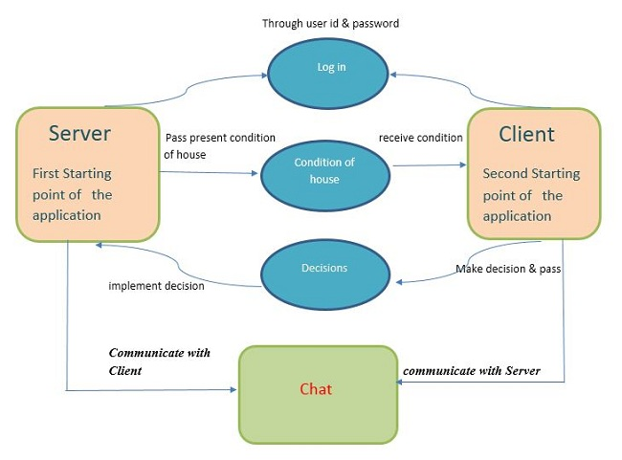
Flow of Control

Slide 9
In this part the client will first connect with the server. Then the client will get the current conditions of his house.
According to the current conditions the client will make decisions.
Through the server the decisions will be implemented at the house.
There is also a option to chat.

Slide 10
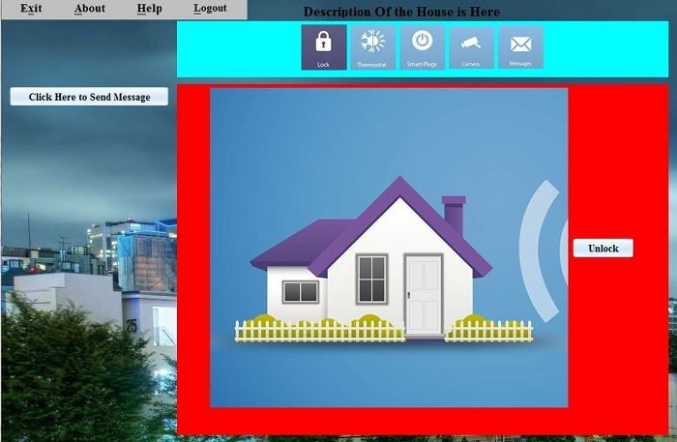
Project window
Panel of
buttons
Chat option
Execution control panel

Slide 11
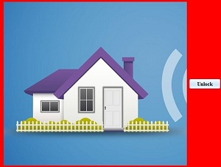
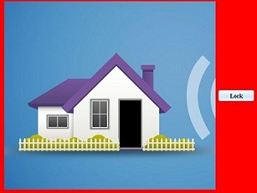
Outputs
Unlockbutton
Click
unlock
Lock
button

Slide 12
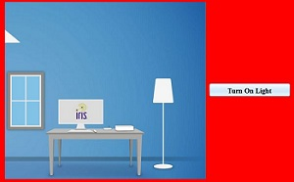
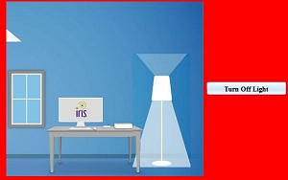
Outputs
Turn on light
button
Click
Turn on light
Turn off light
button

Slide 13
Advantages
We can get connected with our house.
We only need internet connection and a device enabled with this application.
It is independent of place.
This application also works through LAN and Bluetooth.
It has an additional feature of chatting.

Slide 14
Limitation
Our project is only a software simulation. No hardware part is implemented.

Slide 15
Future plan
We will try to develop this “Digital Home” application.
We will add other important features to make this application more helpful to the users.
In future, We will try to develop this “Digital Home” application through hardware implementations.

Slide 16
Conclusion
We have tried our best to make our project “Digital Home” a very simple and user friendly.
We demonstrated our program very simply by modulating java classes.
Our “Digital Home” will help a user to have a control over his house very easily.
We profoundly thank our Superviser sir for his helpings towards our project.

Slide 17
References
Google.
Wikipedia.
JAVA How to program 7th edition.
_________By H.M.Deitel & P.J.Deitel.

Slide 18
Thanks All

